Slide 1
Verification Modulo Versions
Francesco Logozzo
With S. Lahiri, M. Fahndrich, S. Blackshear

Slide 2
Background
Problem Verification of program P’ produces a long set of alarms
Missing annotations on external APIs, handling of the environment …
Ideal Go over the list of alarms and fix all of them
Fix the code, add annotations …
Reality Fixing all the warnings is just too expensive
Slow convergence to 0 alarms
Dream Only report new warnings introduced in P’
But we already have baseline!
“Francesco why are you wasting our time?”

Slide 3


Baseline?
Syntactic baseline Report the set of alarms A(P’) \ A(P)
Problem How do we match the same assertion in P and P’ ?
Syntactic matching inherently brittle
Mask new assertion
Baseline assertion
Resurrect masked assertion

Slide 4
Syntactic Baseline
Brittle How do we match the assertions in different versions of the program?
Line number, position in the method …
Path to the assertion (Coverity)
…
Inherently unreliable No guarantee whatsoever on the reported/masked warnings
Noisy Reported warning may be an old one
Unsound Masked warning may be a new one

Slide 5
VMV: Verification Modulo Versions
Idea
Extract the semantic environmental conditions E from the base program P
Inject E in the new program P’, to generate P’_{E}
Report alarms from P’_{E}
Questions
What are the properties E?
How do we inject them in P’?
Same problem as syntactic baseline?
Which semantic guarantees do we have on P’_{E} output?
Spoiler alert: We can find regressions or we can have relative proofs

Slide 6
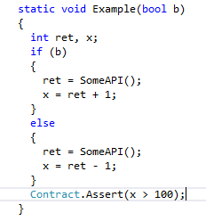
Semantic properties E
Distinguish between sufficient and necessary
Sufficient condition: guarantees there is no bad execution
May remove some good execution
Necessary condition: holds in all the good executions
May not remove all bad executions
(weakest) Sufficient:
ret > 101
(strongest) Necessary:
ret > 99
Sufficient condition?
Necessary condition?

Slide 7
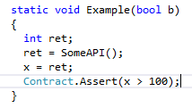
Injection
Can be done at different precision levels
Program points, sequence of method calls, methods
More precise ⇒ more complex syntactic matching
Our solution: Match method calls

Slide 8
Semantic guarantees
Using sufficient conditions VMV(S)
All warnings in P’_{E} are new alarms
But it may mask too many
Sufficient conditions should be under-approximated
At worst false
Using necessary conditions VMV(N)
All proven P’_{E} assertions are correct with respect to P
They hold in the same environmental conditions P was correct
Necessary conditions should be over-approximated
At worst true

Slide 9
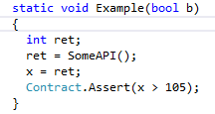
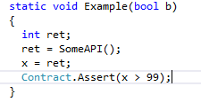
Example
New error!
VMV(S)
ret > 101
VMV(N)
ret > 99
Relative verification!

Slide 10
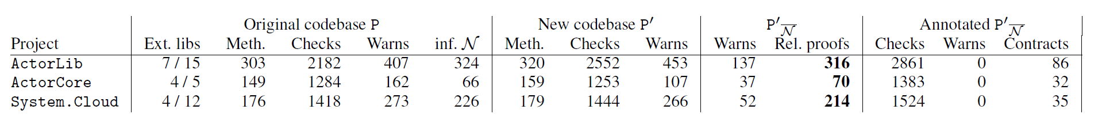
Examples: Azure lib
Three months among P and P’
VMV(N) dramatically reduces the number of alarms (roughly by 70%)
Still semantic guarantees!
VMV(N) eliminated great majority of the warnings from external non-annotated API
We added annotations to P’_{E} to go to 0 warnings
Less than 3 hours overall

Slide 11
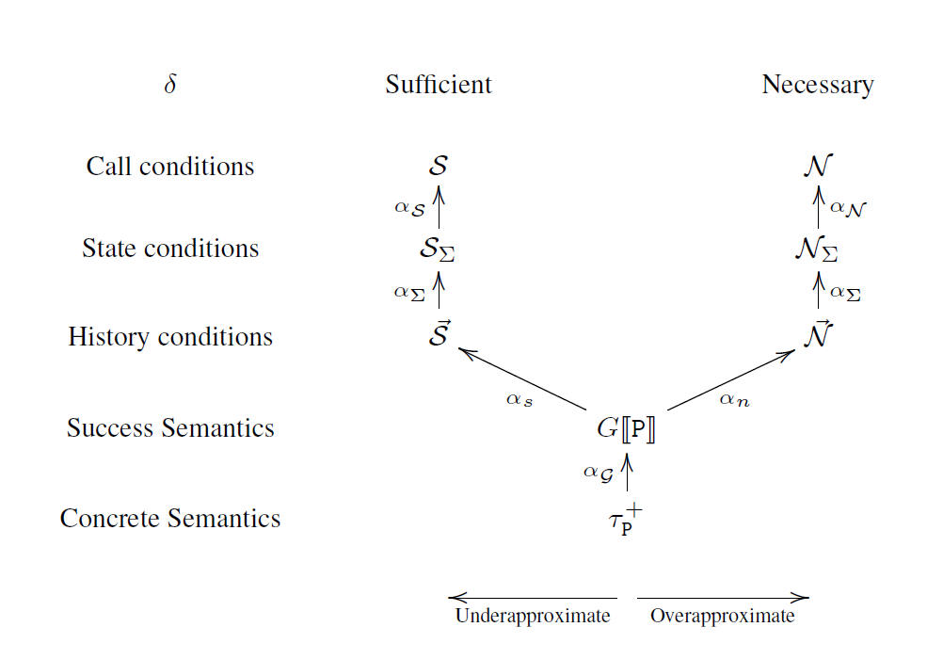
Conclusions
Verification Modulo Versions
Exploit previous versions to refine static analysis/verification
VMV(S) for regression finding
VMV(N) for relative verification
Implemented in Clousot, to be used in ReviewBot
Details on the forthcoming PLDI paper
Abstract regressions, abstractions of necessary/ sufficient, etc.

